Slide 1
Estimation of Flammability Limits for Mixtures

Slide 2
Introduction
Objective
  Develop a calculation tool to estimate the Lower Flammable Limit (LFL) and Upper Flammable Limit (UFL) for mixtures with multiple flammable materials and multiple inerts.
Scope
  Study research articles on methods to calculate LFL and UFL’s and utilize research to create an excel tool
  Compare calculations with experimental data

Slide 3
Background
Flammability Limits
  An air-fuel mixture will only combust between the lower and upper flammability limits
  Correctly calculating the LFL and UFL is important to prevent ignition that may lead to fires or explosions
  Increasing the number of flammable materials and inerts in the mixture increases the complexity in flammability limit calculations and increases potential for error

Slide 4
Research/Selecting Methodology
Goal
  Find and systematize a methodology for calculating LFL and UFL that is both accurate and practical for desired mixtures
  Read research papers based on the use of the Calculated Adiabatic Flame Temperature (CAFT)

Slide 5
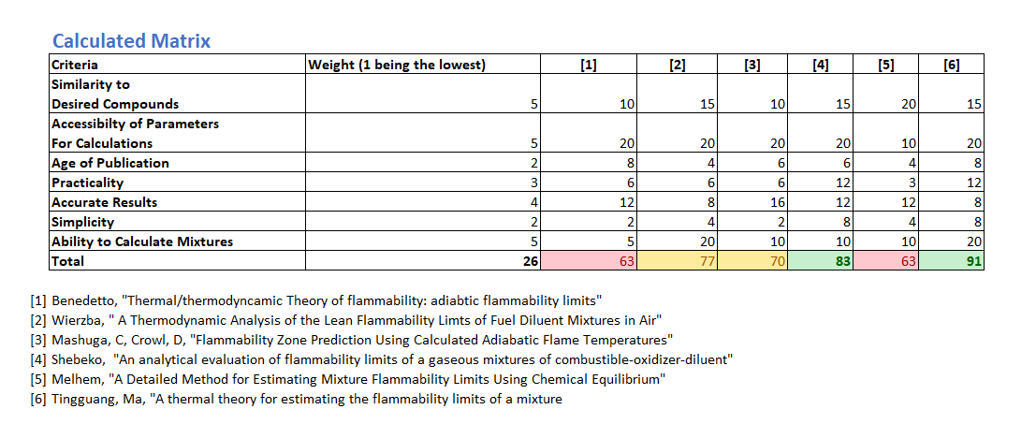
Decision Matrix on Choosing Methodology
Six methods of performing calculations were evaluated based on 7 criteria
Each criteria was given a weight of 1-5, e.g., simplicity – 2; accessibility of parameters - 5
Each method was given a 1-5 rating on each criteria that was then multiplied by the criteria’s weight

Slide 6
Research/Selecting Methodology
Ma’s Method^{[1]} utilizing CAFT was selected
Pros
  Can estimate mixtures with multiple fuels and inerts
  Practical and simple to systematize
  Applicable for a wide range of fuels and inerts
Cons
  Assumes that there is complete combustion at UFL, which may lead to higher error in the UFL calculation
  Limited literature data comparing Ma’s calculated LFL and UFL values with experimental data
[1] Ma, T. (2011). A thermal theory for estimating the flammability limits of a mixture. Fire Safety Journal, 46(8), 558–567. https://doi.org/10.1016/j.firesaf.2011.09.002

Slide 7

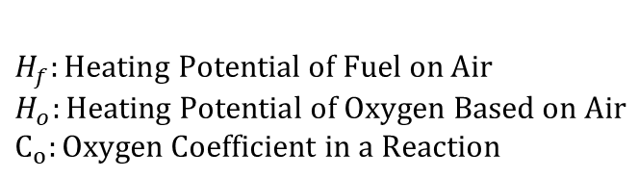
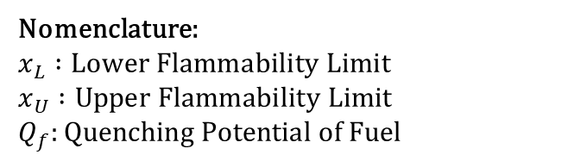
Equation Derivation Non-Inert Mixture
Energy Balance
Quenching of Fuel + Quenching of Air = Energy Released by Fuel
$$x_{L}Q_{f}+\left(1−x_{L}\right)=x­_{L}H­_{F}$$
$$x_{U}Q_{f}+\left(1−x_{U}\right)=\left(\frac{1−x_{U}}{4.773}\right)H_{o}$$
Energy terms are additive
$${H_{f}}_{mix}=\sum_{i}{H_{f,i }y_{i}},{H_{o}}_{mix}=\sum_{i}{H_{\begin{aligned}o i \\ \end{aligned}} y_{i}}, {Q_{f}}_{mix}=\sum_{i}{Q_{f,i }y_{i}}, {C_{o}}_{mix}=\sum_{i}{C_{o,i }y_{i}}$$
Calculate flammability limits
$x_{L}=\frac{1}{1+H_{f}−Q_{f}}$ $x_{U}=\frac{\frac{H_{o}}{4.773}−1 }{\begin{aligned}\frac{H_{o}}{4.773}−1+Q_{f} \\ \end{aligned}}$
Nomenclature:
$$x_{L} :Lower Flammability Limit$$
$$x_{U} :Upper Flammability Limit$$
$$Q_{f}:Quenching Potential of Fuel$$
$$H_{f}:Heating Potential of Fuel on Air$$
$$H_{o}:Heating Potential of Oxygen Based on Air$$
$$C_{o}:Oxygen Coefficient in a Reaction$$

Slide 8
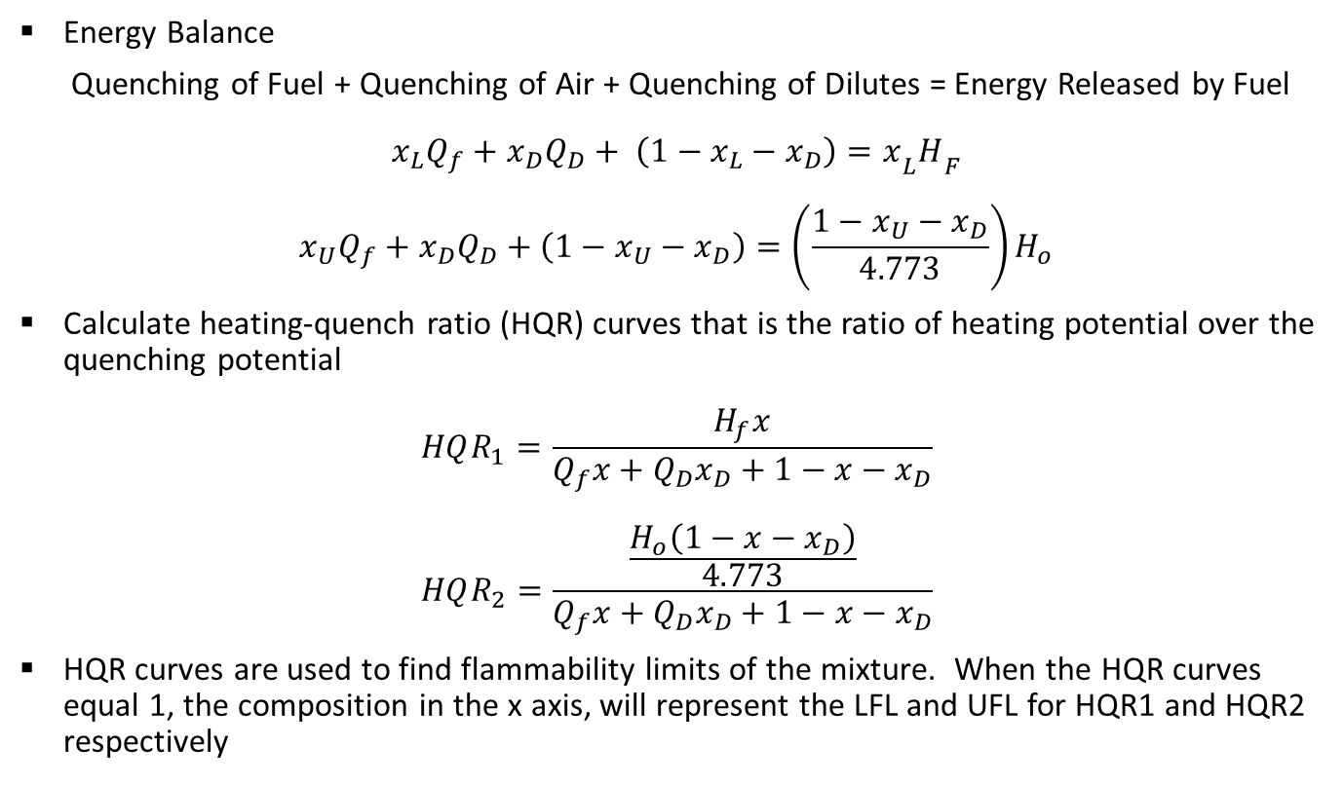
Equation Derivation Mixture With Inerts
Energy Balance
Quenching of Fuel + Quenching of Air + Quenching of Dilutes = Energy Released by Fuel
$$x_{L}Q_{f}+x_{D}Q_{D}+ \left(1−x_{L}−x_{D}\right)=x­_{L}H­_{F}$$
$$x_{U}Q_{f}+x_{D}Q_{D}+\left(1−x_{U}−x_{D}\right)=\left(\frac{1−x_{U}−x_{D}}{4.773}\right)H_{o}$$
Calculate heating-quench ratio (HQR) curves that is the ratio of heating potential over the quenching potential
$$HQR_{1}=\frac{H_{f}x}{Q_{f}x+Q_{D}x_{D}+1−x−x_{D}}$$
$$HQR_{2}=\frac{\frac{H_{o}\left(1−x−x_{D}\right)}{4.773}}{Q_{f}x+Q_{D}x_{D}+1−x−x_{D}}$$
HQR curves are used to find flammability limits of the mixture. When the HQR curves equal 1, the composition in the x axis, will represent the LFL and UFL for HQR1 and HQR2 respectively

Slide 9
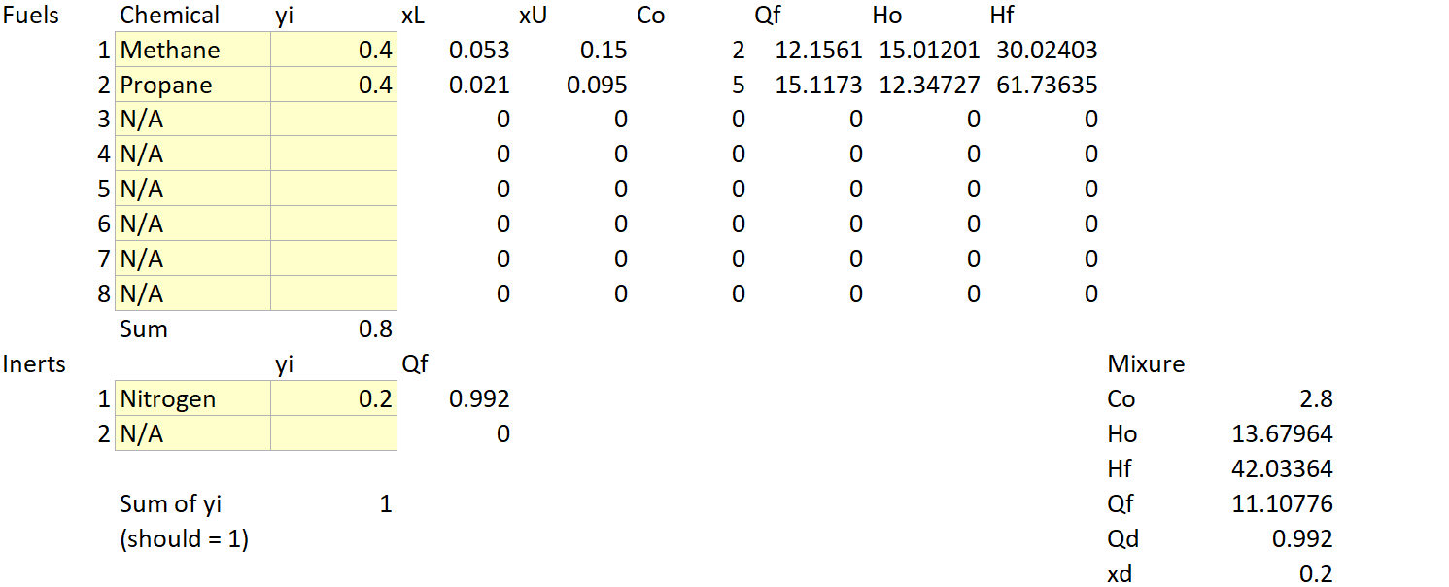
Excel Tool - 1
An Excel tool was created to calculate LFL and UFL for mixtures
Uses a list of common fuels and inerts that can be selected in drop down window
Graphs HQR curves for mixtures with inerts to find LFL and UFL

Slide 10
Excel Tool – 2

Slide 11
Results
Used Excel tool to compare results with Ma’s calculations
[1] Ma’s Calculation; [2] Current Tool
[1] Ma’s Calculation; [2] Current Tool; [3] Le Chatelier’s Method
Very similar results between Ma’s calculation and our calculated values
Similar results in non-dilute mixture with Le Chatelier’s Method (LCR)
Diluted Methane Mixture
Yi Methane | Yi N2 | Yi CO2 | LFL Calc [1] | LFL Calc [2] | LFL % Error [1] vs [2] | UFL Calc [1] | UFL Calc [2] | UFL % Error [1] vs [2]
0.152 | 0.798 | 0.05 | 0.353 | 0.355 | 0.57 % | 0.441 | 0.44 | 0.23 %
Non-Dilute Mixture
Yi Ethyl Acetate | Yi Ethanol | Yi Toluene | LFL Calc [1] | LFL Calc [3] | LFL Calc [2] | LFL % Error [1] vs [2] | UFL Calc [1] | UFL Calc [3] | UFL Calc [2] | UFL % Error [1] vs [2]
0.635 | 0.208 | 0.014 | 0.0206 | 0.0207 | 0.0208 | 0.97 % | 0.1144 | 0.1133 | 0.1139 | 0.44 %

Slide 12
Results – Comparison with Terpstra’s Research - 1

Slide 13
Results – Comparison with Terpstra’s Research – 2
Flammability Limits for Methane Mixture 30% Methane/ 70% Diluent
Diluent | LFL Obs | LFL Calculate | % Error | UFL observed | UFL calc | % Error
Helium | 0.177 | 0.169 | 4.5% | 0.303 | 0.343 | 13.2%
Argon | 0.16 | 0.169 | 5.6% | 0.317 | 0.343 | 8.2%
CO2 | 0.187 | 0.195 | 4.3% | 0.29 | 0.306 | 5.5%

Slide 14
Results – Comparison with Kondo’s Research - 1

Slide 15
Conclusions
Calculation method and excel tool calculated the LFLs for a variety of mixtures accurately: 4 – 8 % error
Had a larger range of error (8 – 14%) for UFL calculations, which increases as the fraction of inert increases
Overall, the calculation tool and method handled a wide range of inerts and fuels delivering results with acceptable error relative to experimental data
Certain inerts can cause error due to changing of flame temperature (e.g., Halon 1301)
  The calculation assumes a constant flame temperature
Be cautious when using this calculation method for UFL
  Error is higher because the model assumes complete combustion which is not totally appropriate at the UFL concentration

Slide 16
Future Work/Next Steps
Continue comparing calculations with experimental data
Calculate the Limiting Oxygen Concentration (LOC)
Adjust calculations for actual temperature and pressure conditions

Slide 17
Questions?
Acknowledgment:
Thank you to Silvio Esterellas, Tony Rocha-Valadez, and ExxonMobil for support and guidance on this research

Slide 18
References
[1] Ma, T. (2011). A thermal theory for estimating the flammability limits of a mixture. Fire Safety Journal, 46(8), 558–567. https://doi.org/10.1016/j.firesaf.2011.09.002
[2] Kondo, S., Takizawa, K., Takahashi, A., Tokuhashi, K., & Sekiya, A. (2007). Flammability limits of isobutane and its mixtures with various gases. Journal of Hazardous Materials, 148(3), 640–647. https://doi.org/10.1016/j.jhazmat.2007.03.021
[3] Terpstra, M. (2012). Flammability limits of hydrogen-diluent mixtures in air. University of Calgary, Calgary, AB.
https://doi.org/10.11575/PRISM/26185
[4] Crowl, D. A., & Louvar, J. F. (2019). Chemical Process Safety: Fundamentals with Applications. Pearson.

